Slide 1
Tracking Sleep movement using wearable technologies
Elizabeth Chin and Chichi Illoh
Notes:
Our project is about tracking sleep with wearable technology

Slide 2
Table of contents
01
02
03
Background
Data Description
Introduction
04
05
04
Methodology
Results
Conclusions
Notes:
In our presentation we are going to provide background information regarding sleep and sleep studies, an introduction to our project, a description of the data we obtained, and the methodology used to answer our research questions. We are also going to discuss our results and conclusion made as well as the potential future works that can be done

Slide 3
Background
You can give a brief description of the topic you want to talk about here. For example, if you want to talk about Mercury, you can say that it’s the smallest planet in the entire Solar System
Notes:
We will first talk about our background

Slide 4
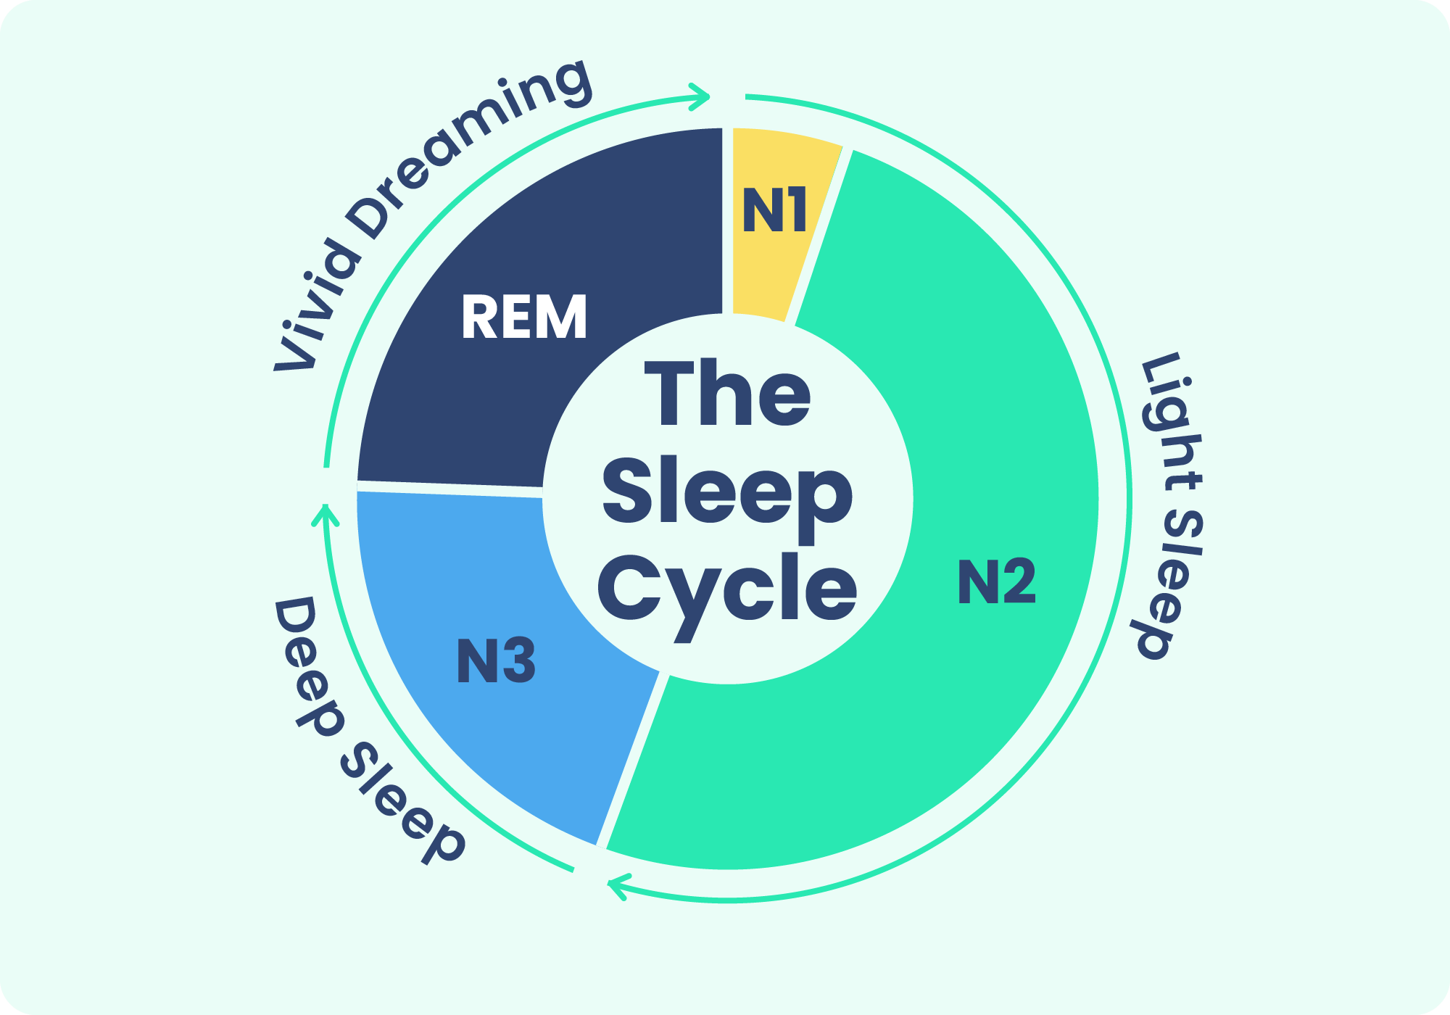
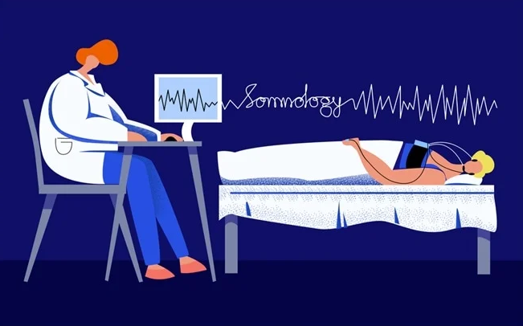
Background
Sleep is divided into two main stages:rapid eye movement (REM) and non-REM sleep
The gold standard for monitoring sleep is polysomnography (PSG) as it measures brain waves, muscle activity, heart rate, and respiration
Other alternatives for monitoring sleep in studies include actigraphy-measures motor activity with a noninvasive accelerometer
Notes:
Sleep is divided into two main sleep stages: non-REM and REM. WIthin the non-REM stage, there are three stages, all with different lengths: N1, N2, and N3. WIthin these stages the muscles in the body begin to relax and brain waves start to slow. The most movement that would be recorded would come from the N1 stage. During the REM cycle, however, brain activity picks up and the body experiences temporary paralysis. When it comes to sleep studies, the gold standard for monitoring sleep is polysomnography or PSG because it measures brain waves, muscle activity, heart rate, and respiration. PSG though is expensive and not always practical sp another alternative for monitoring sleep is actigraphy which uses an accelerometer to observe motor activity during sleep.

Slide 5
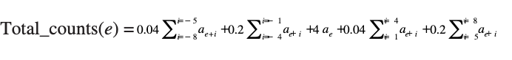
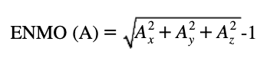
Data Description
Where the data comes from
The dataset is from the Queensland University of Technology Research Data Repository
The original study looks to observe the sleep of 14 adults (9 male, 5 female) with the Philips Actiwatch(gold standard for actigraphy) and Apple watch and compare the accuracy and performance of the watches
Data was given where each csv contained data for a given participant on a given night
The two variables of importance:
Actiwatch activity counts
Apple Watch ENMO
Variable | Description
timestamp | Date when observation was measured (every 15 secs. )
Actiwatch activity counts | raw acceleration measurement transformed into one value
Sleep classification | Sleep(0) or awake(1)
Apple Watch ENMO | raw acceleration measurement transformed into one value
Notes:
The dataset is from the Queensland University of Technology Research Data Repository
The original study looks to observe the sleep of 14 adults (9 male, 5 female) with the Philips Actiwatch(gold standard for actigraphy) and Apple watch and compare the accuracy and performance of the watches
Data was given where each csv contained data for a given participant on a given night
Variables in the dataset were timestamp, actiwatch activity counts, sleep classification, and apple watch ENMO.
The two variables of focus for our project were the Actiwatch activity counts and the Apple Watch ENMO variables.
The Actiwatch activity counts is formed from raw acceleration measurements and the Philips’ Actiware software computes the total activity counts at epoch e using a weighted sum
The Apple watch ENMO variable is also formed using raw acceleration data from the Apple Watch. This acceleration data was then used to calculate ENMO using the formula above

Slide 6
Introduction
You can give a brief description of the topic you want to talk about here. For example, if you want to talk about Mercury, you can say that it’s the smallest planet in the entire Solar System
Notes:
Next is an introduction to the project

Slide 7
Introduction
Why this field?
Sleep studies are beneficial for improving sleep patterns, learning more about cycles, and understanding sleep disorders like sleep apnea
Wearable devices tend to overestimate sleep and cannot currently detect different stages of sleep
Research Questions
We plan to compare two wearable devices and attempt to detect sleep stages of the subjects
Are the activity counts measured by the Philips Actiwatch correlated to the ENMO variable measured by the Apple Watch?
Are there identifiable cycles seen by the activity counts from the Actiwatch or the ENMO variable from the Apple Watch?
Notes:
Sleep studies are beneficial for improving sleep patterns, making further advancements in learning about sleep stages, and understanding sleep disorders like sleep apnea. We were also interested in doing this topic because wearable devices tend to overestimate sleep and cannot currently detect different stages of sleep.
Our plan is to compare the two wearable device s and attempt to detect sleep stages for each participant
Our first research question is looking at the relationship between the Philips Actiwatch activity counts and the ENMO variable measured from the Apple watch
And Our second research question is looking to identify any cyclical behavior within each participant for bothe the activity counts and ENMO variable

Slide 8
Methods
You can give a brief description of the topic you want to talk about here. For example, if you want to talk about Mercury, you can say that it’s the smallest planet in the entire Solar System

Slide 9
Methods
Data Wrangling
EDA
Lags
Modeling Oscillations
1
Despite being red, Mars is cold
2
It’s the closest planet to the Sun
3
Saturn is a gas giant and has rings
4
Venus has high temperatures

Slide 10
Methods Cont.
Data Wrangling
Merging the datasets into one
Removing a participant from the dataset because they did not complete the study
Multiple imputation by median and zero inflation model
EDA
Trajectories by subject ID for Actiwatch activity counts and Apple Watch ENMO
Notes:
Since the dataset have a significant number of zero values from the “Actiwatch.activity.counts” column, we used a zero-inflation model to account for the excess zeros
Which splits the column into two distributions: one zero distribution and a non-zero distribution
To model a probability of 0 we use logistic regression to predict the presence of zeros and in the non-zero distribution, poisson model was used
Maximum likelihood estimation is used to fit the model to the data and help with finding parameter estimates to fill in missing values
For other variables that do not have an excess of zeros but might have missing values, we used Median imputation because it is robust to outliers and can provide a central tendency measure that minimizes the impact of extreme values.
We applied median imputation to Apple.Watch.ENMO and Actiware.classification column so that the imputation preserves the distribution characteristics of the dataset.

Slide 11
Methods Cont: Lags
Lag Definition
Represents the relative passage of time rather than absolute time
How Lag is being used
It suggests that the ENMO (Euclidean Norm Minus One) influences or associates with subsequent changes on activity counts measured by ActiWatch
Notes:
.

Slide 12
Methods: Modeling Oscillations
Cycles: continually repeated with little variation in a periodic and regular fashion
Our plan was to model oscillations to be able to identify the sleep stages (REM and non-REM ) for each participant
Additionally, we would like to find out how long a sleep cycle takes for each participant.
To do this and answer our research question, we plan to do spectral analysis and wavelet analysis
Notes:
To answer our second research question our plan was to model oscillations to identify the two main sleep stages REM and non-REM for each participant. We also planned to identify the length of a sleep cycle for each subject. And to do this we planned on using spectral analysis and wavelet analysis
With spectral analysis
We plan to use the periodogram to provide insight on identifying the dominant frequencies based on the power of a signal.
With wavelet analysis
We can interpret how the frequency evolves over time and identify where there are strong and weak oscillations
The red representing high power (strong oscillations) and blue representing low power (weak oscillations).

Slide 13
Results
You can give a brief description of the topic you want to talk about here. For example, if you want to talk about Mercury, you can say that it’s the smallest planet in the entire Solar System

Slide 14
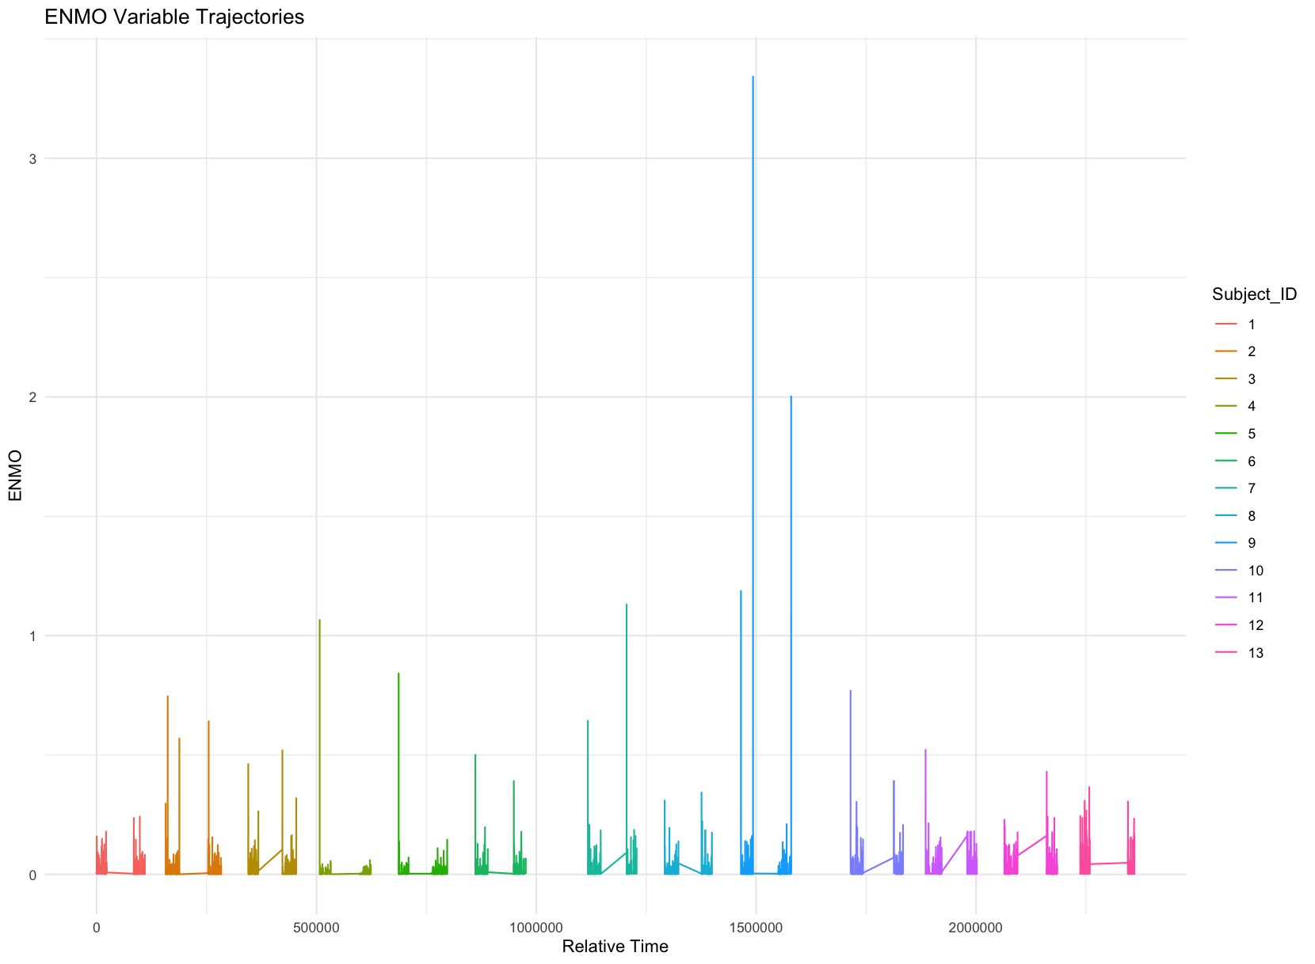
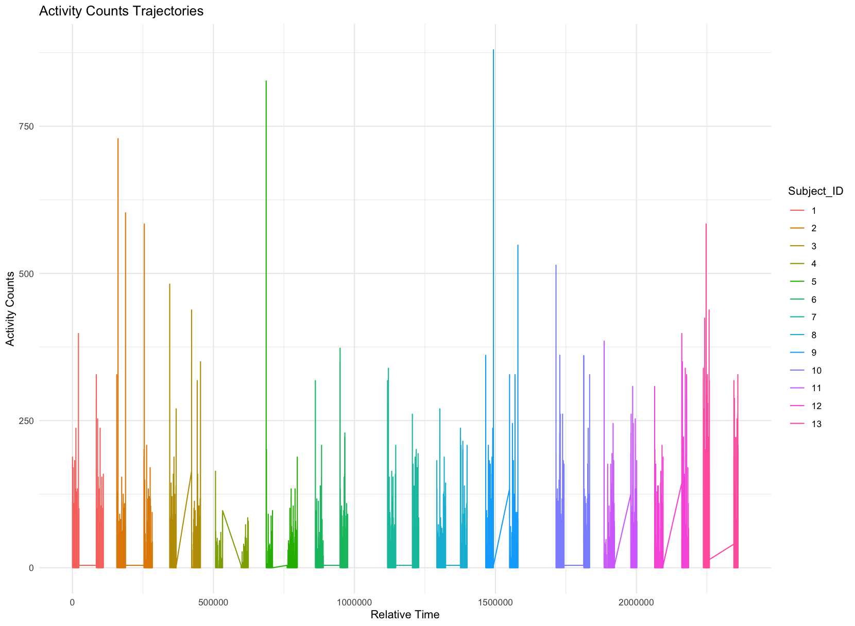
Results: EDA
Notes:
Trajectory for activity Philips Acitwatch activity counts
Subjects all start at different time points or dates
2 bars of the same color represent night 1 and night 2 of each subject
Would not categorize as stationary as there seems to be great variation in all subjects
The same can be said for the ENMO variable

Slide 15
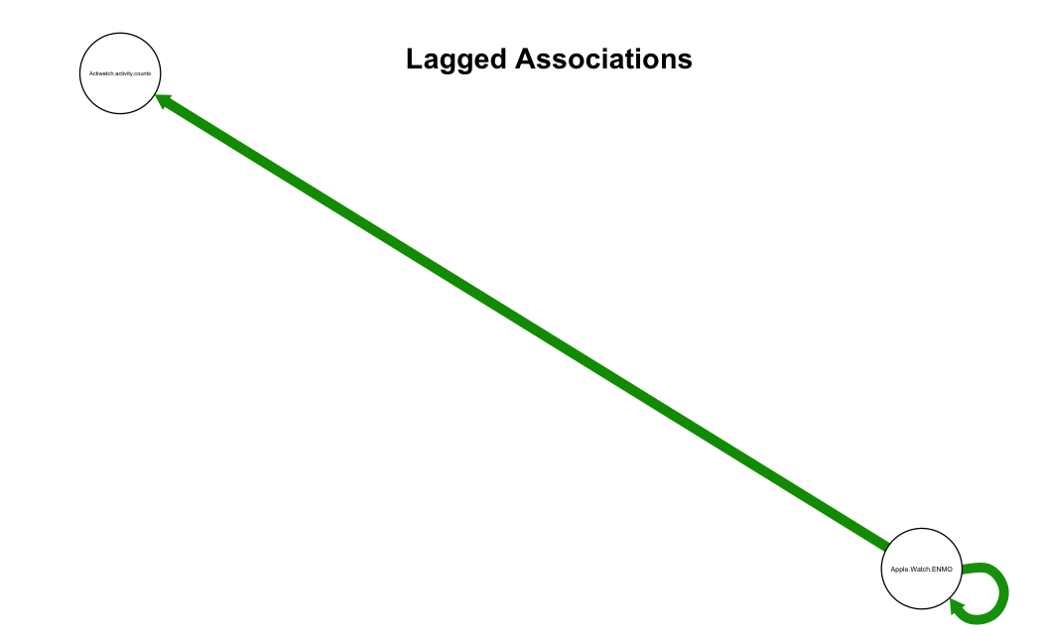
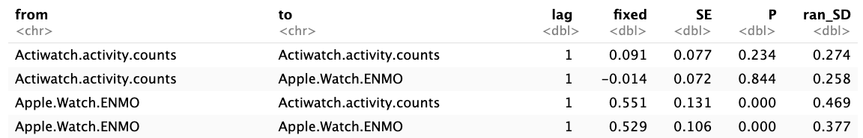
Results:Lags
Notes:
The dark green line suggests that Apple.Watch.ENMO predicts Actiwatch.activity.counts at the next time point positively.
Apple.Watch.ENMO has a stronger auto regressive effect because the line is thicker and darker.
Apple.Watch.ENMO is more inert over time than Actiwatch.activity.counts generally across the people in the sleep study.
Apple.Watch.ENMO is a bigger driver than Actiwatch.activity.counts and the relationship is a positive one.
Apple.Watch.ENMO -> Actiwatch.activity.counts (lag 1): relationship
The fixed effect coefficient of 0.551 in the context of the relationship between Apple.Watch.ENMO and Actiwatch.activity.counts indicates that for every unit increase in the ENMO measurement from the Apple Watch, there is an expected increase of 0.551 units in the activity counts measured by the Actiwatch. This positive coefficient suggests a strong positive correlation between the two measures, implying that higher ENMO values on the Apple Watch are associated with higher activity counts on the Actiwatch. This relationship is statistically significant, given that the p-value (low P-value) is significantly less than the alpha threshold of 0.05. The random standard deviation (ran_SD) is 0.469, indicates that there is high variability across subjects.
The formulas serve different purposes, such that ENMO derives activity levels from accelerometer vectors and Total_counts(e) is used to aggregate activity levels over time. Thus they measure related aspects of physical activity and can provide complementary information in the context of sleep monitoring. Which is why they have a high correlation of 0.845
Between-Subject Effects:
- The table shows that there is a high correlation between Apple.Watch.ENMO and Actiwatch.activity.counts across subjects (cor = 0.845).
- The partial correlation (pcor) is 0.845. This high value suggests that, after accounting for the influence of other variables in the model, there is still a strong linear relationship between the random effects of Apple.Watch.ENMO and Actiwatch.activity.counts.

Slide 16
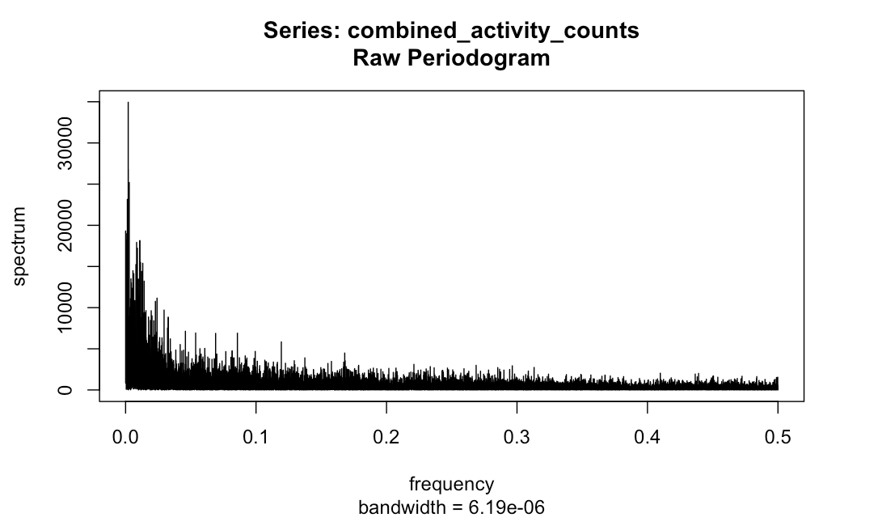
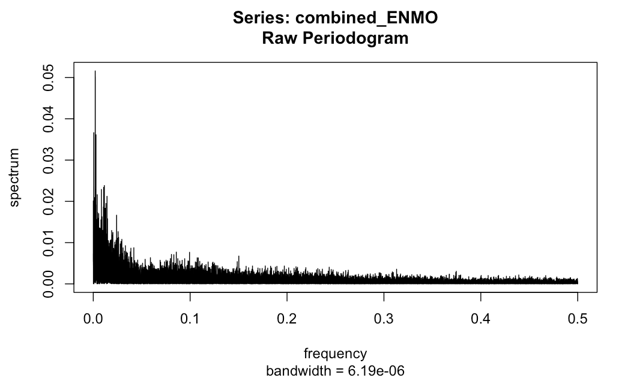
Results:Periodogram
Notes:
The x axis is showing the range of frequencies in the signal and the y axis is showing the power of the signal at each frequency
There is a peak near the 0 frequency which means that most of the ENMO signal is concentrated at low frequencies
The power decrease rapidly in both graphs suggesting that the signal is dominated by slow variation
varies slowly over time
which corresponds to a long periodic component or trend.
In other words, the time series has a component that varies slowly over time, potentially indicating a trend or a very long-term cycle.
Comparing the Activity counts and the ENMO periodogram the higher signal means more variations

Slide 17
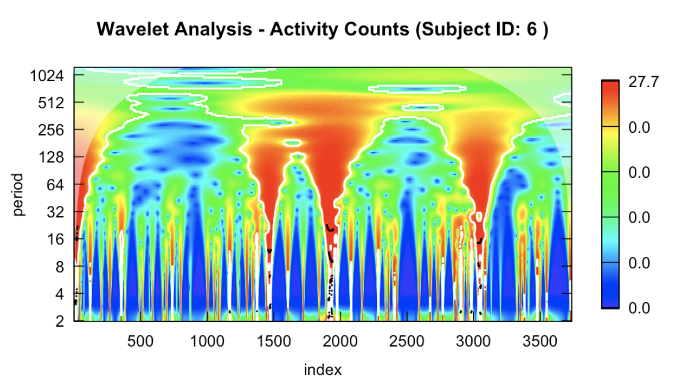
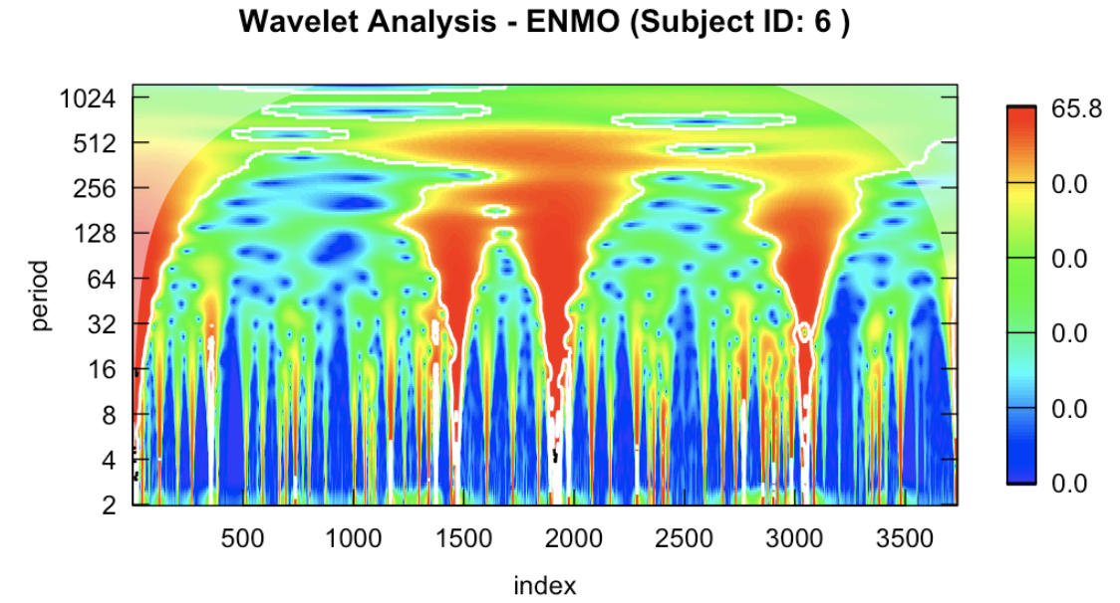
Results:Modeling Oscillations
Notes:
Compare b/t activity counts and enmo-similarity suggesting that oscillation changes don’t differ between the watches
At around ____ seconds the oscillatory changes are stable and there is a strong spectral density at this point
The red representing high power (strong oscillations) and blue representing low power (weak oscillations).
Subject 3 and 6 have long strong oscillation

Slide 18
Conclusion
You can give a brief description of the topic you want to talk about here. For example, if you want to talk about Mercury, you can say that it’s the smallest planet in the entire Solar System

Slide 19
Conclusions & Future Works
Conclusion
Future Works
Mercury is the closest planet to the Sun and the smallest one in the Solar System—it’s only a bit larger than the Moon
Venus has a beautiful name and is the second planet from the Sun. It’s hot and has a poisonous atmosphere
Notes:
Conclusion:
Lags: There is a strong positive correlation between the two measures, implying that higher ENMO values on the Apple Watch are associated with higher activity counts on the Actiwatch
Modeling Oscillations: Oscillatory changes are not stable and change over time for most of the subjects. There are several reasons for this like the oscillatory behavior is not stationary and this may be because the sleep stages are not the same throughout the observed time. There are also biological, behavioral, environmental, and health related factors that can could have played a role in why we couldn't find stable oscillatory changes
Future Works:
Imputation clustering (ML)
Other imputation methods or other ways to fill in NA values in the dataset
Improving research/ study design
Having participants monitor their sleep at same dates-this can help in reducing some variation
Having sleep monitored for more than two nights
Including a variable that distinguishes the night when measure was observed (night 1 or night 2)
For the discrete time: create a cutoff in time so that there is a same number of evenly spaced time units for each subject

Slide 20
Thanks!
Any Questions?

